Slide 1

THE 1983-84 NHL SEASON IN RETROSPECT

Slide 2
Season Overview
The NHL’s 1984 season was a pivotal one for several reasons:
The Islanders’ run of four consecutive Stanley Cup victories came to an end, at the hands of…
The Oilers, who captured their first Cup with Gretzky and went on win five out of the next seven league championships.
The Penguins and Devils tanked for the first overall pick, with the Penguins employing some questionable strategies, like benching hot goalies, to eventually earn the right to draft Mario Lemieux from the top slot

Slide 3
Season Format
Each team played 80 games, with the following layout:
Clarence Campbell Conference
Norris Division (5 teams: CBH, DET, MNS, STL, TOR)
Smythe Division (5 teams: CGY, EDM, LAK, VAN, WIN)
Prince of Wales Conference
Adams Division (5 teams: BOS, BUF, HAR, MON, QUE)
Patrick Division (6 teams: NJD, NYI, NYR, PHI, PIT, WAS)
Overtime was re-introduced to the league’s regular season format, although games could still end in ties; it had not been in use since the 1942-43 season
Overtime losses did not yield the “loser” point, but teams that tied both earned 1 point

Slide 4
Season Format
The playoff format was straightforward: the top four teams from each division qualify, meaning that eight teams make it from each conference
No byes were given; instead, the first two rounds took place only within each division.
In the division semi-finals, the regular season division champs played the team ranked fourth in their division, while the second and third teams in each division squared off; these series were best-of-five
For the division finals, the two remaining teams from each division faced off, this time in a best-of-seven
The conference finals and Stanley Cup finals (both best-of-seven) finally introduced intra-division matchups, as first the remaining team from the Norris & Smythe and Adams & Patrick played each other, and then the conference champs faced off

Slide 5
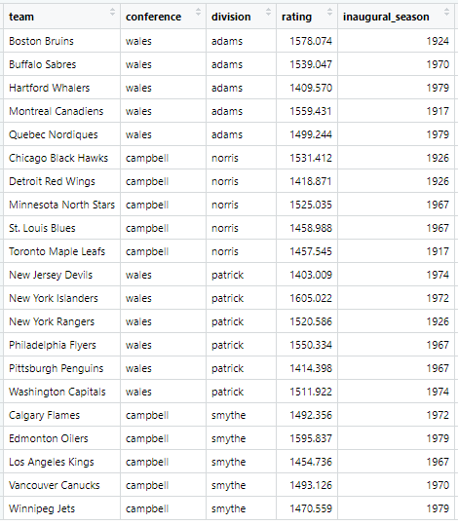
Preseason ELO Ratings
Expected division winners & playoff teams:
Adams: Boston, Montreal, Buffalo, Quebec
Norris: Chicago, Minnesota, St. Louis, Toronto
Patrick: NY Islanders, Philadelphia, NY Rangers, Washington
Smythe: Edmonton, Vancouver, Calgary, Winnipeg

Slide 6
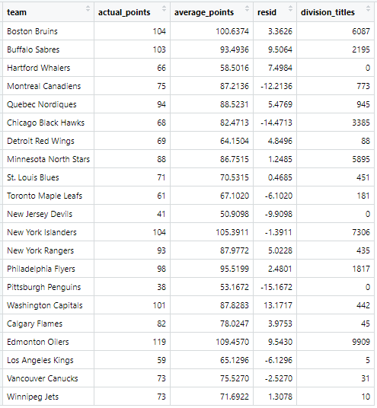
Simulated Regular Season Results

Slide 7
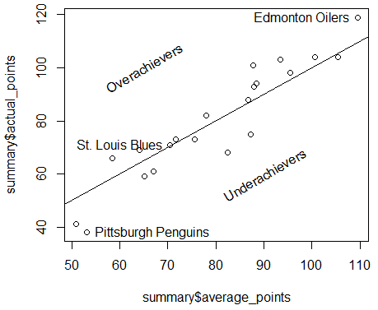
Comparison of Simulation and Actual Regular Season
Many teams slightly overperformed or slightly underperformed, which is to be expected
In general, the model was accurate, with cor(actual, average) = .941
The biggest overachievers in real life tended to be the best teams from the simulation, while the biggest underachievers were the worst teams in the simulation
cor(actual_points, residual) = .716

Slide 8
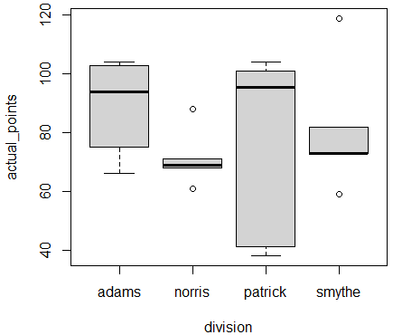
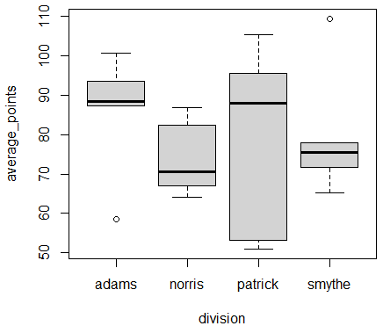
Comparison of Simulation and Actual Regular Season
The model had a very accurate depiction of the league’s landscape, even at the divisional level
The spread and median of each division’s actual point totals is nearly identical to the values predicted by the model

Slide 9
Discussion of Regular Season Results
The model correctly predicted Boston, Minnesota, Edmonton, and NY Islanders to win their divisions
The Penguins and Devils were correctly expected to finish in the basement of the league
Both were by far the worst in the league during 1984, and both had the lowest playoff chances at .48% and .19% respectively
The model also correctly identified Hartford and Los Angeles as two other non-playoff teams
The model said that Detroit would be the first team out, and Toronto would be the last team in
If this was flipped, the model would have correctly picked all 16 playoff teams in 1984, order notwithstanding
Very few surprises with regards to playoff berths

Slide 10
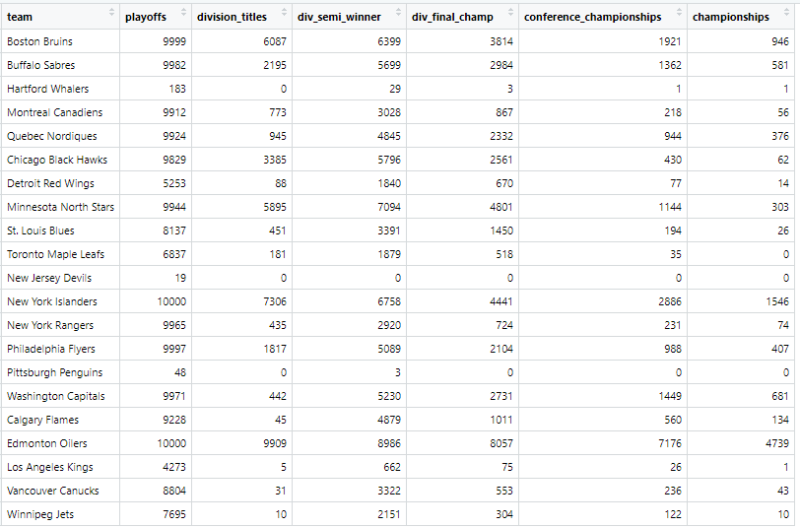
Simulated Playoff Results

Slide 11
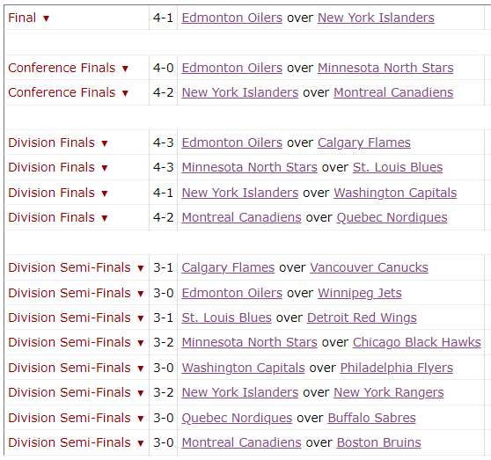
Actual Playoff Bracket

Slide 12
Comparison of Simulated and Actual Playoff Results
The playoffs generally played out how ELO predicted
Even though Washington greatly over-performed during the regular season, the Capitals still suffered their most likely fate, according to the model: a second-round exit (sound familiar?)
The Canadiens were the lone surprise coming out of the Division Finals, as they were only expected to advance to the Conference Finals 8.67% of the time, having the seventh-best chances to do so in the Wales Conference
They knocked out the Bruins in round 1, who was the heavy favorite to advance out of the Adams division
The Oilers and Islanders were correctly picked to move on to the Cup Final, and the Oilers were ultimately the unquestioned champ, not only from the simulation but also in reality

Slide 13
Three Teams Overview
St. Louis Blues
During the 1983-84 season, the Blues recorded 71 points, good for second in the Norris Division
They defeated Detroit in the Division Semi-Finals before losing in seven games to the North Stars in the Division Finals
The model expected them to record 70.5315 points, make the playoffs 81.37% of the time, and usually bow out in the Division Finals, an incredibly accurate set of predictions
Washington Capitals
The Capitals were the closest thing to a pleasant surprise during the 1983-84 regular season, earning 101 points, 3 points back of the Patrick Division-winning Islanders
They swept the Flyers in the Division Semi-Finals, but were taken down by the Islanders in 5 games in the Patrick Division Finals
The model predicted them to collect 87.82 points and make the playoffs 99.71%, but had them winning the Stanley Cup 6.81% of the time, fourth highest in the league

Slide 14
Three Teams Overview
Chicago Black Hawks
Chicago recorded a disappointing 68 points, well below their projection of 82.4713, and still managed a fourth-place finish in the Norris Division
They were defeated in five games by Minnesota in the Division Semi-Finals
The model expected them to advance to the conference final about 25% of the time, which they fell well short of reaching

Slide 15
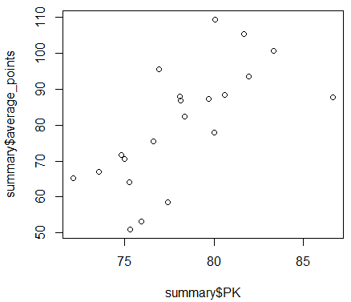
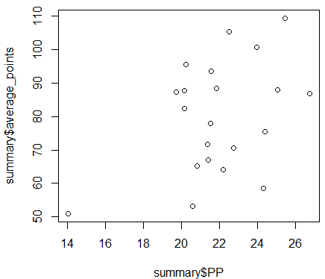
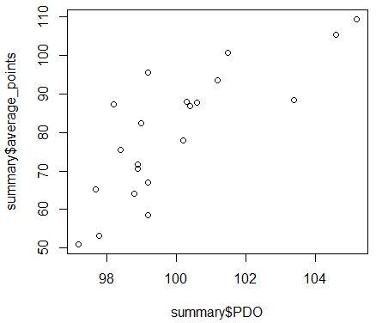
Relevant Statistics
We will use power play %, penalty kill %, and PDO to generally assess these teams. The league averages for each are respectively 21.9%, 78.2%, and 100, and they exhibit the following trends with average points:

Slide 16
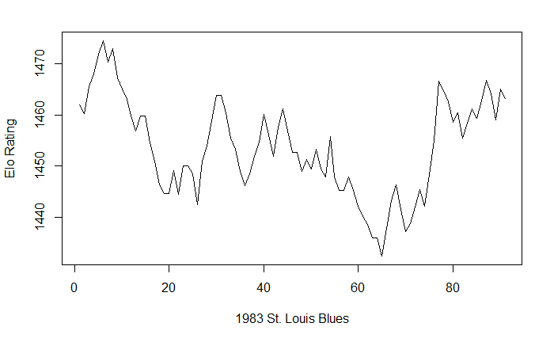
Analysis of Average Team
The Blues had the league’s seventh best power play, the 18th best penalty kill, and the 14th best luck. Though they featured star goalie Mike Liut and future Hall of Famers Bernie Federko, Joe Mullen, and Doug Gilmour, they weren’t good enough at any one thing to push themselves over the top.

Slide 17
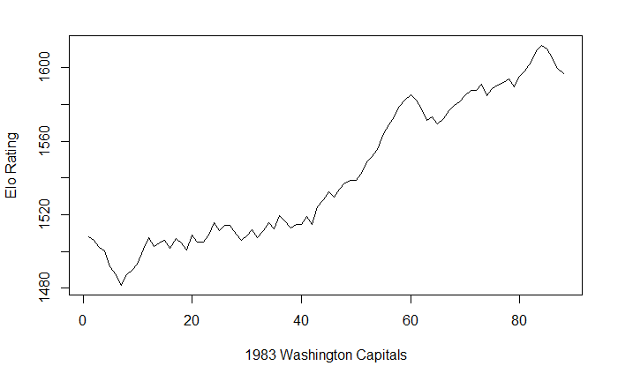
Analysis of Overachieving Team
The Caps allowed the fewest goals as a team, 226, experienced above-average PDO, and had the league’s best penalty kill, which made up for having the third-worst power play. They accordingly boasted three future Hall of Fame defensemen, but were likely done in by a lack of scoring ability as their luck ran out against the Islanders in the Patrick Division finals.

Slide 18
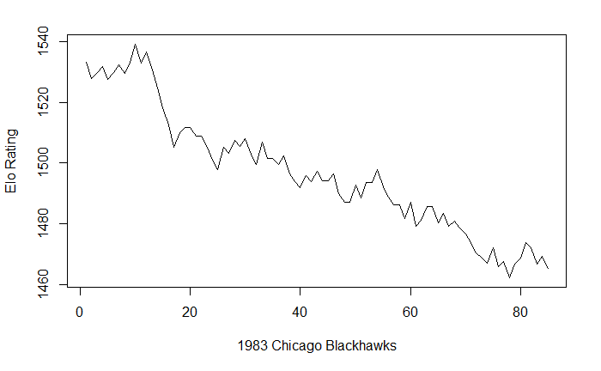
Analysis of Underachieving Team
Chicago’s combination of a mediocre penalty kill, weak power play, and bad luck was unsurprisingly not very successful. They fell 34 points from the season before, when they made the Conference Finals, and rebounded the next year to make it just as far. This just seems like a case of a good team having a down year.

Slide 19
Conclusions/Takeaways
As important as it was, the 1983-84 NHL season was quite stable, in that there few upsets of note and everything nearly played out as expected
The takeover of the league by the Oilers felt inevitable, and the ELO model confirmed this feeling
The tank war for Lemieux that forever altered the NHL landscape was the result of league-leading underachievement by the Penguins in 1984

